Slide 1

NFT – PLATFORM
Project Work – ii PRESENTATION
Department of Computer Science and Engineering
Submitted By:
Tanishq Porwal
EN18CS301280

Slide 2
About Company
Fourty Seven Billion Information Technologies Pvt. Ltd. is a product engineering services company that specializes in end-to-end product development. We have experts who understand your business domain, they will define your product requirements, visualize the product from all the touch-points of your end customers, design intuitive user interfaces, develop a solid and scalable architecture, suggest an appropriate infrastructure stack, and develop a high-quality, scalable product that is ready to go live with a large number of your customers.
We have technical expertise in various areas like big data analytics, cloud computing, IoT, and mobile and web applications. They had successfully deployed many projects in telecom, logistics, agriculture, ad-tech, tourism, education, healthcare, ERP for SMEs, IoT, and Digital signages and Kiosks.
We are Handling projects from all over the globe, from the delivery centers in Indore, Bangalore India and Santa Clara California.
Some of our major clients are Cisco, aPlaceforMom, visp.net, Nazara, Apsalar, CAVO eD, L SQUARED, AGRI BOLO, Sodexo, jio and many more.

Slide 3
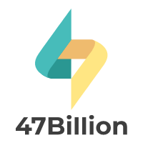
Company Profile
Website : www.47billion.com
Industries : Software Development
Company Size : 100 – 200 employees
Headquarters : Santa Clara, California
Incorporated on : 2012
Other Offices : Indore, Bangalore India
CEO : Mr. Amol Vaidya
CTO : Mr. Rajeev Dixit

Slide 4
Internship Details
Company : Fourty Seven Billion Information Technologies Pvt. Ltd.
Internship Type : Off – Campus
Location : Indore
Role : Software Engineer Intern
Start Date : 05th January 2022
End Date : 20th April 2022
External Guide : Mr. Snehal Agrawal

Slide 5
Internship Profile
My profile at 47Billion was Software Engineer Intern. I was a part of the backend team and mainly worked on Blockchain technology. I had contributed in:
Writing smart contracts
Working with web3.js
Working with IPFS
Deploying and testing smart contracts on Rinkeby Test Network

Slide 6
Initial Training
Initial training was given to me for a better understanding of the tools and technologies. The tools and technologies learned by me during the training period are:
Git and GitLab
Remix IDE
Solidity
IPFS
MetaMask
Ganache
Truffle
Hardhat
JavaScript
Web3.js
ReactJs

Slide 7
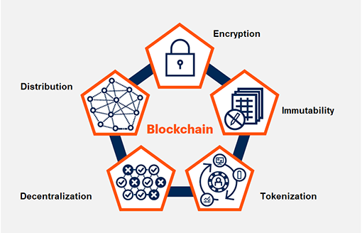

Blockchain
Blockchain is a shared, immutable ledger that facilitates the process of recording transactions and tracking assets in a business network. An asset can be tangible (a house, car, cash, land) or intangible (intellectual property, patents, copyrights, branding).
It is a system of recording information in a way that makes it difficult or impossible to change, hack, or cheat the system
Main features of blockchain are :- It runs on decentralized system, transaction details are stored in containers called blocks, immutable and cryptographically secure.

Slide 8

Remix IDE
It is an open-source web and desktop application. It fosters a fast development cycle and has a rich set of plugins with intuitive GUIs. Remix IDE allows developing, deploying and administering smart contracts for Ethereum like blockchains.
Remix IDE is a powerful open-source tool that helps us to write Solidity contracts straight from the browser. It is written in JavaScript. Remix IDE has modules for testing, debugging and deploying of smart contracts and much more

Slide 9
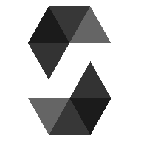
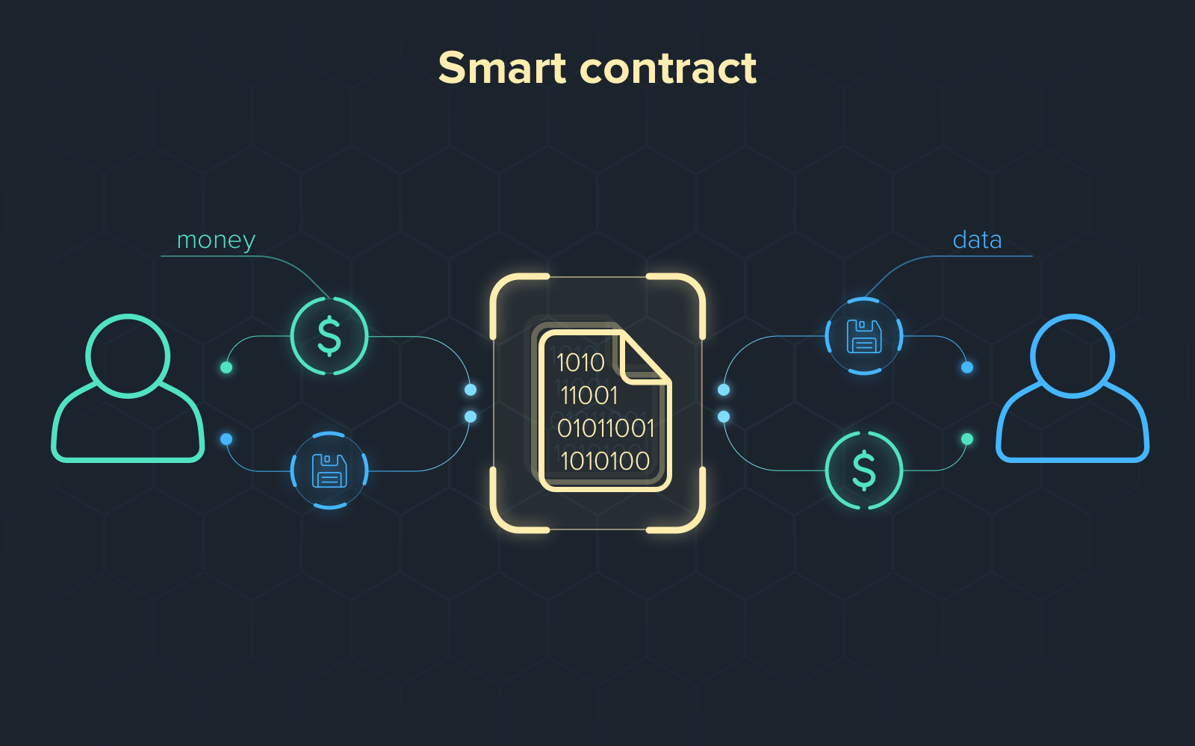
Solidity
Solidity is an object-oriented, high-level language for implementing smart contracts. It is a curly-bracket language designed to target the Ethereum Virtual Machine (EVM). EVM is the runtime environment for smart contracts in Ethereum. EVM focuses on providing security and executing untrusted code by computers all over the world.
Smart Contracts
Smart Contracts are simply programs stored on a blockchain that run when predetermined conditions are met. They typically are used to automate the execution of an agreement so that all participants can be immediately certain of the outcome, without any intermediary's involvement or time loss.

Slide 10
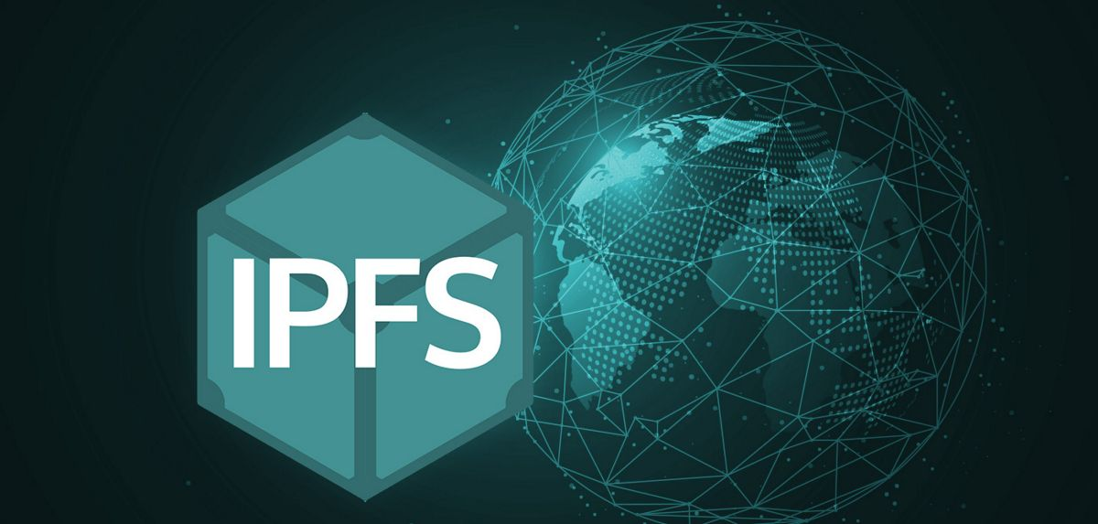
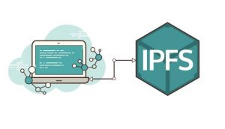
IPFS
It is a distributed system for storing and accessing files, websites, applications, and data. It is basically a peer-to-peer (p2p) storage network. Content is accessible through peers located anywhere in the world, that might relay information, store it, or do both. IPFS knows how to find what you ask for using its content address rather than its location.

Slide 11
JavaScript
JavaScript is a lightweight, cross-platform, object-oriented and interpreted scripting language which is used to make webpages interactive (e.g., having complex animations, clickable buttons, popup menus, etc.).
JavaScript can be used for Client-side developments as well as Server-side developments.
Callback Function: A callback is a function that is passed as an argument to another function. This technique allows a function to call another function.
Async & Await Function: An async function is a function declared with the async keyword, and the await keyword is permitted within it. The async and await keywords enable asynchronous, promise-based behavior to be written in a cleaner style, avoiding the need to explicitly configure promise chains.

Slide 12
Web3.js
Web3.js is a collection of libraries that allow you to interact with a local or remote ethereum node using HTTP, IPC or WebSocket. It is a collection of JS libraries and helps us to communicate with Smart Contract through MetaMask.
There are various methods provided by web3. Some of them are:
web3.eth.getAccounts: It returns a list of accounts the node controls in the form of an array.
web3.eth.getBalance: It returns the current balance for the given wallet address in wei.
web3.eth.getTransactionReceipt: It returns the receipt of a transaction by transaction hash. The receipt is not available for pending transactions and returns null.

Slide 13
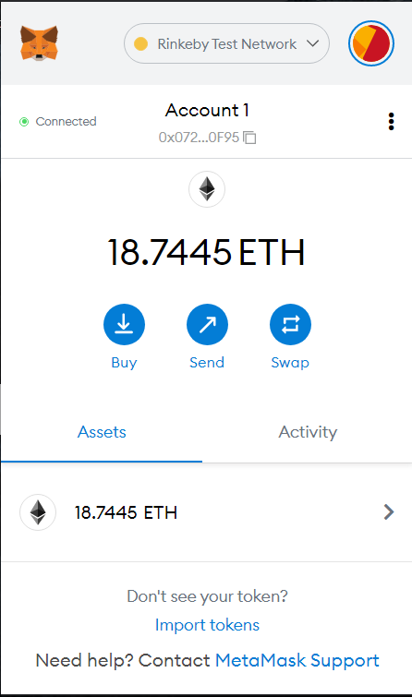
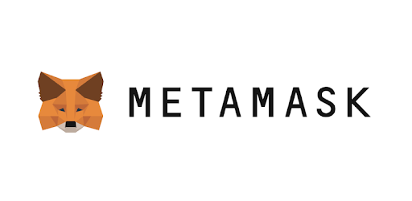
MetaMask
MetaMask is a crypto wallet and gateway to blockchain apps.
It allows users to access their Ethereum wallet through a browser extension or mobile app, which can then be used to interact with decentralized applications.
MetaMask provides the simplest yet most secure way to connect to blockchain-based applications.
It comes pre-loaded with fast connections to the Ethereum blockchain and several test networks such as Rinkeby (An Ethereum test network that allows for blockchain development testing before deployment on Mainnet, the main Ethereum network).

Slide 14
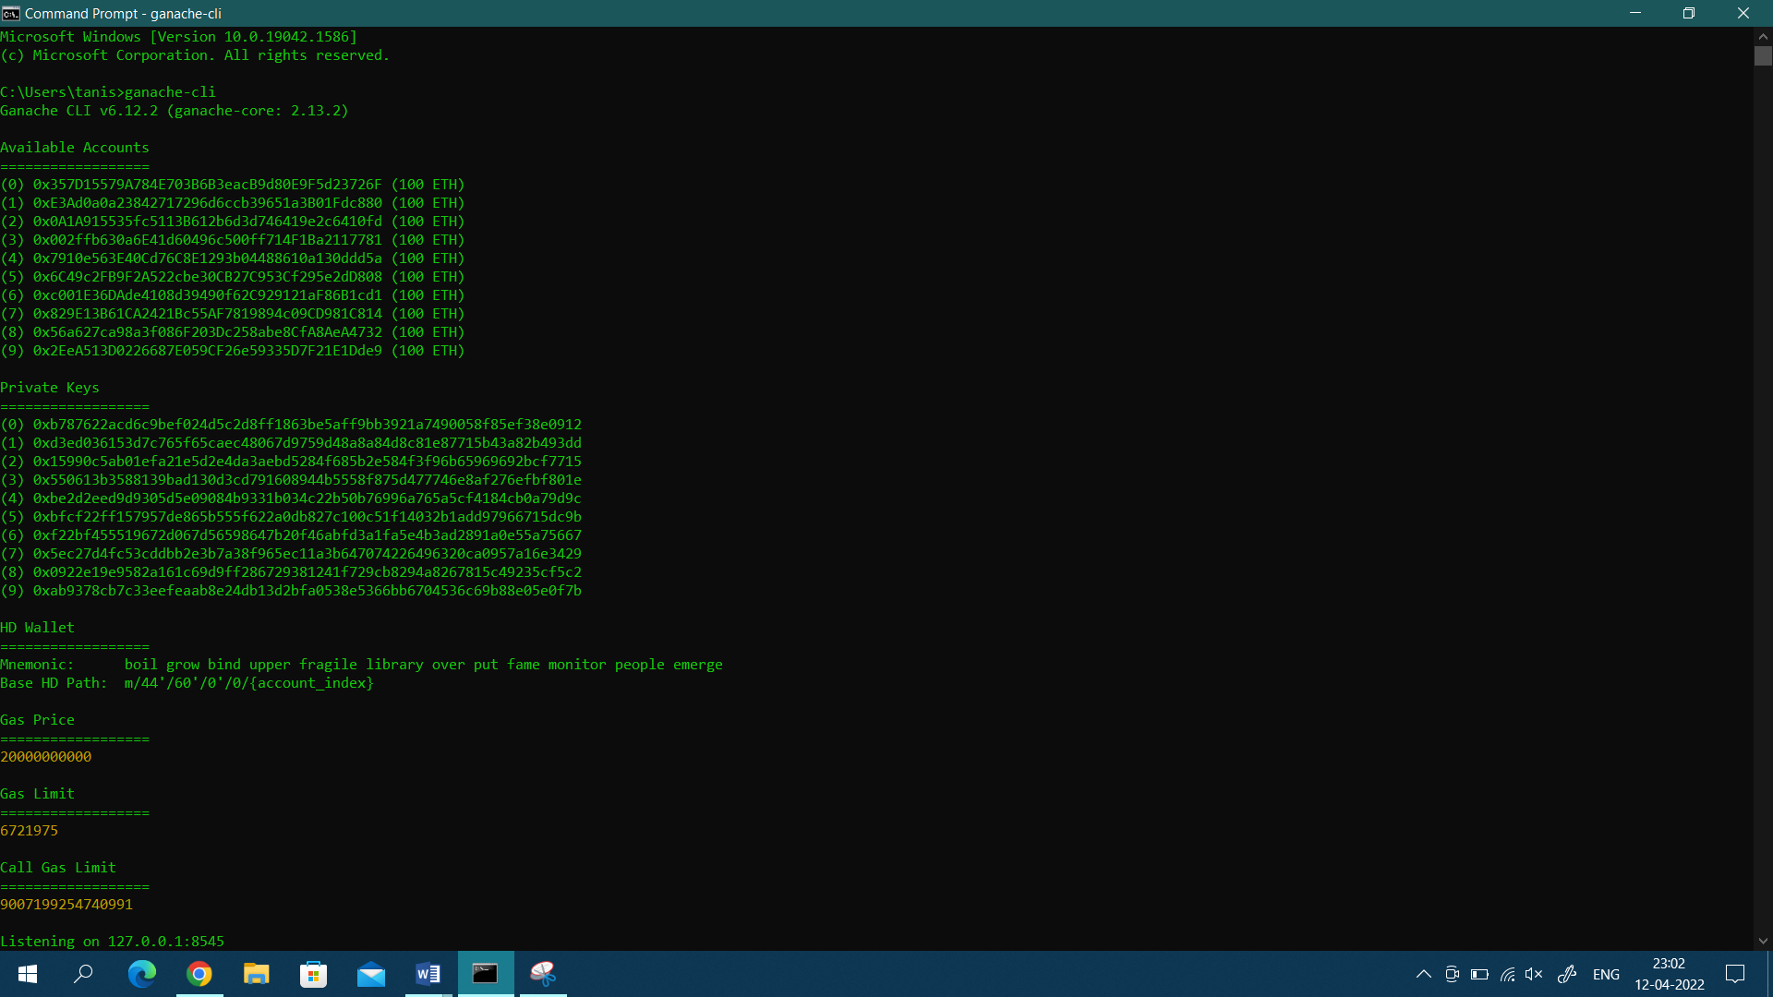

Ganache
Ganache is a personal blockchain for rapid Ethereum and Corda distributed application development. You can use Ganache across the entire development cycle: enabling you to develop, deploy, and test your dApps in a safe and deterministic environment.
In short, it is your local blockchain simulator which quickly fire up a personal Ethereum blockchain which you can use to run tests, execute commands, and inspect state while controlling how the chain operates.

Slide 15
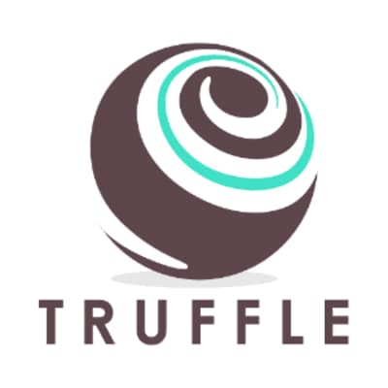
Truffle
Truffle is the most popular development tooling for Ethereum programmers. With truffle, we can easily deploy smart contracts and communicate with their underlying state without heavy client-side programming. It is an especially useful library for the testing and iteration of Ethereum smart contracts.
truffle config.js: It is a file that is used to configure the truffle project. It is seeded with some common settings for different networks and features like migration, compilation and testing.
Some basic commands of Truffle are:
truffle compile: Used to compile the smart contracts.
truffle migrate: Used to deploy the smart contracts on the local blockchain network.
truffle migrate --reset: It runs all migrations from the beginning instead of running from the last completed migration.

Slide 16
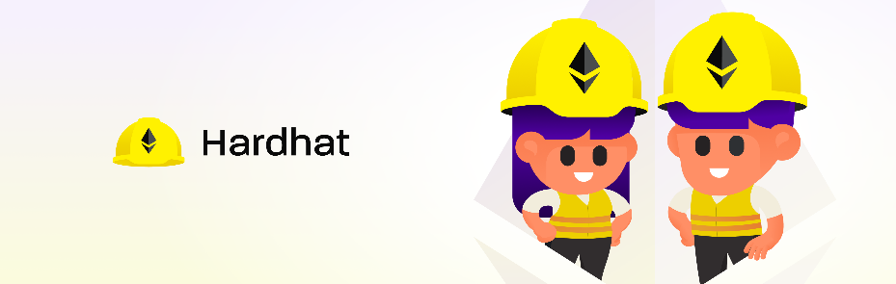
Hardhat
Hardhat is an Ethereum development environment for professionals. It facilitates performing frequent tasks, such as running tests, automatically checking code for mistakes or interacting with a smart contract. It is built by the Nomic Foundation for the Ethereum community.
Hardhat comes with a pre-built local Ethereum network designed with development at its core. This network focuses on Solidity debugging and features stack traces, messages when transactions of the dApps fail, etc. This provides the developers with essential tools to understand where an application fails and provides them with the answer to solve them.

Slide 17
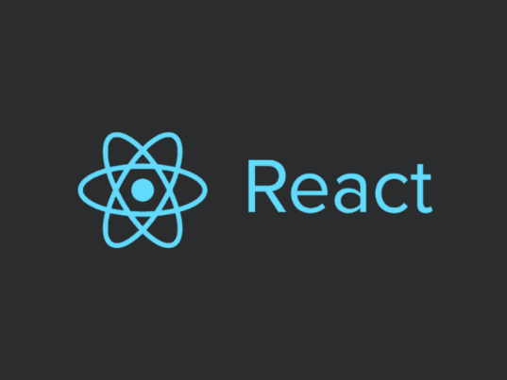
ReactJs
ReactJs is a javaScript library for building user interfaces. It allows us to create reusable UI components.
It is an open-source, component-based front end library responsible only for the view layer of the application.
The main objective of ReactJS is to develop User Interfaces (UI) that improves the speed of the applications.
The create-react-app is an excellent tool, which allows us to create and run React project very quickly.
This tool sets up the development environment, provides an excellent developer experience, and optimizes the application for production.

Slide 18
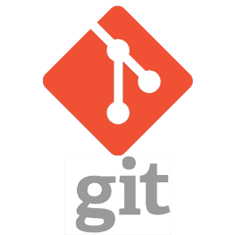
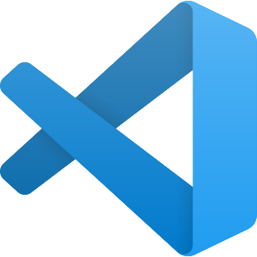
Git
Git is a free and open source distributed version control system designed to handle everything from small to very large projects with speed and efficiency.
Visual Studio Code
Visual Studio Code is a code editor, redefined and optimized for building and debugging modern web and cloud applications.

Slide 19
About Project
The project NFT – Platform is a web application based on Blockchain Technology.
Main business logic is written in Smart Contracts using Solidity Programming Language, which will be stored on Blockchain.
Smart Contracts were created and tested in Remix IDE.
The main aim of the project is to get ownership of any digital art, collectibles, etc as an NFT. The ownership can be transferred in replacement of an Ethereum token (ETH) and complete transaction details will be available on the Ethereum blockchain.

Slide 20
Project Description
The Project is to create an NFT – Platform where:
User will first connect with the MetaMask Wallet.
Upload an NFT.
NFT and its Metadata will get uploaded on the decentralized platform IPFS.
If the user wants to sell an NFT, he/she will enter the price (in Ether).
The one who likes NFT can buy it. 20% service fees will be charged that is 20% of the price of NFT, Ether will be transferred to the organization’s wallet that provides the NFT – Platform service and the remaining Ether will be transferred to the seller’s wallet.
If the user doesn’t want to sell his/her NFT, he/she can remove it from sell.
Moreover, the user has also an option to Burn NFT. If, he/she doesn’t want to sell NFT or don’t want to be the owner of NFT.

Slide 21
Problem Statement
Blockchain has become an emerging technology and with blockchain, the concept of decentralization has also emerged which allows users to store the data decentralized. In order to maintain transparency and making it difficult or impossible to change or hack the ownership of NFTs. This NFT – Platform is created where people can create, sell and buy digital assets (NFT) whose complete data will be stored in the Ethereum Blockchain and complete transaction details can be easily viewed on the blockchain.

Slide 22
Objectives
The objectives of the project are:
To provide a platform where people can create/mint digital assets as NFT like art, gifs, etc.
To provide a platform where people can see the NFTs and buy them if they like.
To maintain the ownership of NFT decentralized so that it becomes difficult or impossible to change, hack, or cheat the system.
All the operations performed on the platform will be stored in Blockchain to maintain proper transparency.

Slide 23
NFT (Non-Fungible Token)
NFT are cryptographic assets on a blockchain with unique identification codes and metadata that distinguish them from each other. NFTs can represent real-world items like artwork and real estate.
"Tokenizing" these real-world tangible assets makes buying, selling, and trading them more efficient while reducing the probability of fraud.
NFTs can also function to represent individuals' identities, property rights, and many more.
Anyone can view the images (NFTs) online for free. So why are people willing to spend millions on something they could easily screenshot or download?
NFT allows the buyer to own the original item. Not only that, it contains built-in authentication, which serves as proof of ownership.

Slide 24
Tools and Technologies Used
Programming Language: Solidity
Decentralized Platform: IPFS
Library: web3.js
Tools: Ganache, Truffle
IDE: Remix, Visual Code Studio
Crypto Wallet: MetaMask
Git Repository: GitLab

Slide 25
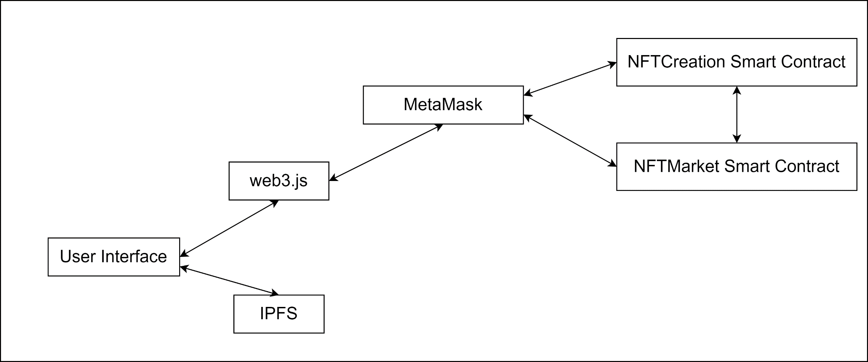
Project Architecture

Slide 26
NFTCreation Smart Contract for creation (minting) of NFT, Maintaining the NFTs which follows ERC 721 standard, Transfer of Ownership, etc.
NFTMarket Smart Contract for performing various operations on NFT such as Buy, Sell, Transferring of Ethers, etc.
This project is based on blockchain which will help users to get ownership of any digital art, collectibles, etc as an NFT.
The ownership can be transferred in replacement of Ethereum token (ETH) and complete transaction detail will be available on the Ethereum blockchain.

Slide 27
Ethereum ERC Standards
ERC is an acronym that stands for Ethereum Request for Comments. ERCs are application-level standards for Ethereum and can include token standards, name registries, library/package formats, and more. Anyone can create an ERC, but it is the author’s responsibility to clearly explain their standard and foster support for it within the community.
Common ERC standards define a required set of functions for a token type, allowing applications and smart contracts to interact with them in a predictable way.
The most common ERC standard is the ERC-20, a type of standard that makes the creation, use, and exchange of Ethereum-based tokens quite simple.
Crypto-enthusiasts should be aware of the issues that may arise when different projects adopt limited functionality from each standard, making their smart contracts different from a proper ERC standard.

Slide 28
ERC 721 Standard
ERC721 is a standard for representing ownership of non-fungible tokens, that is where each token is unique.
It provides functionalities like to transfer tokens from one account to another, to get the current token balance of an account, to get the owner of a specific token and also the total supply of the token available on the network. Besides these it also has some other functionalities like to approve that an amount of token from an account can be moved by a third party account.
If a Smart Contract implements the following methods and events it can be called an ERC-721 Non-Fungible Token Smart Contract and, once deployed, it will be responsible to keep track of the created tokens on Ethereum
All NFTs have a uint256 variable called tokenId, so for any ERC-721 Contract, the pair contract address, uint256 tokenId must be globally unique.
ERC721 is a more complex standard than ERC20, with multiple optional extensions, and is split across a number of contracts.

Slide 29
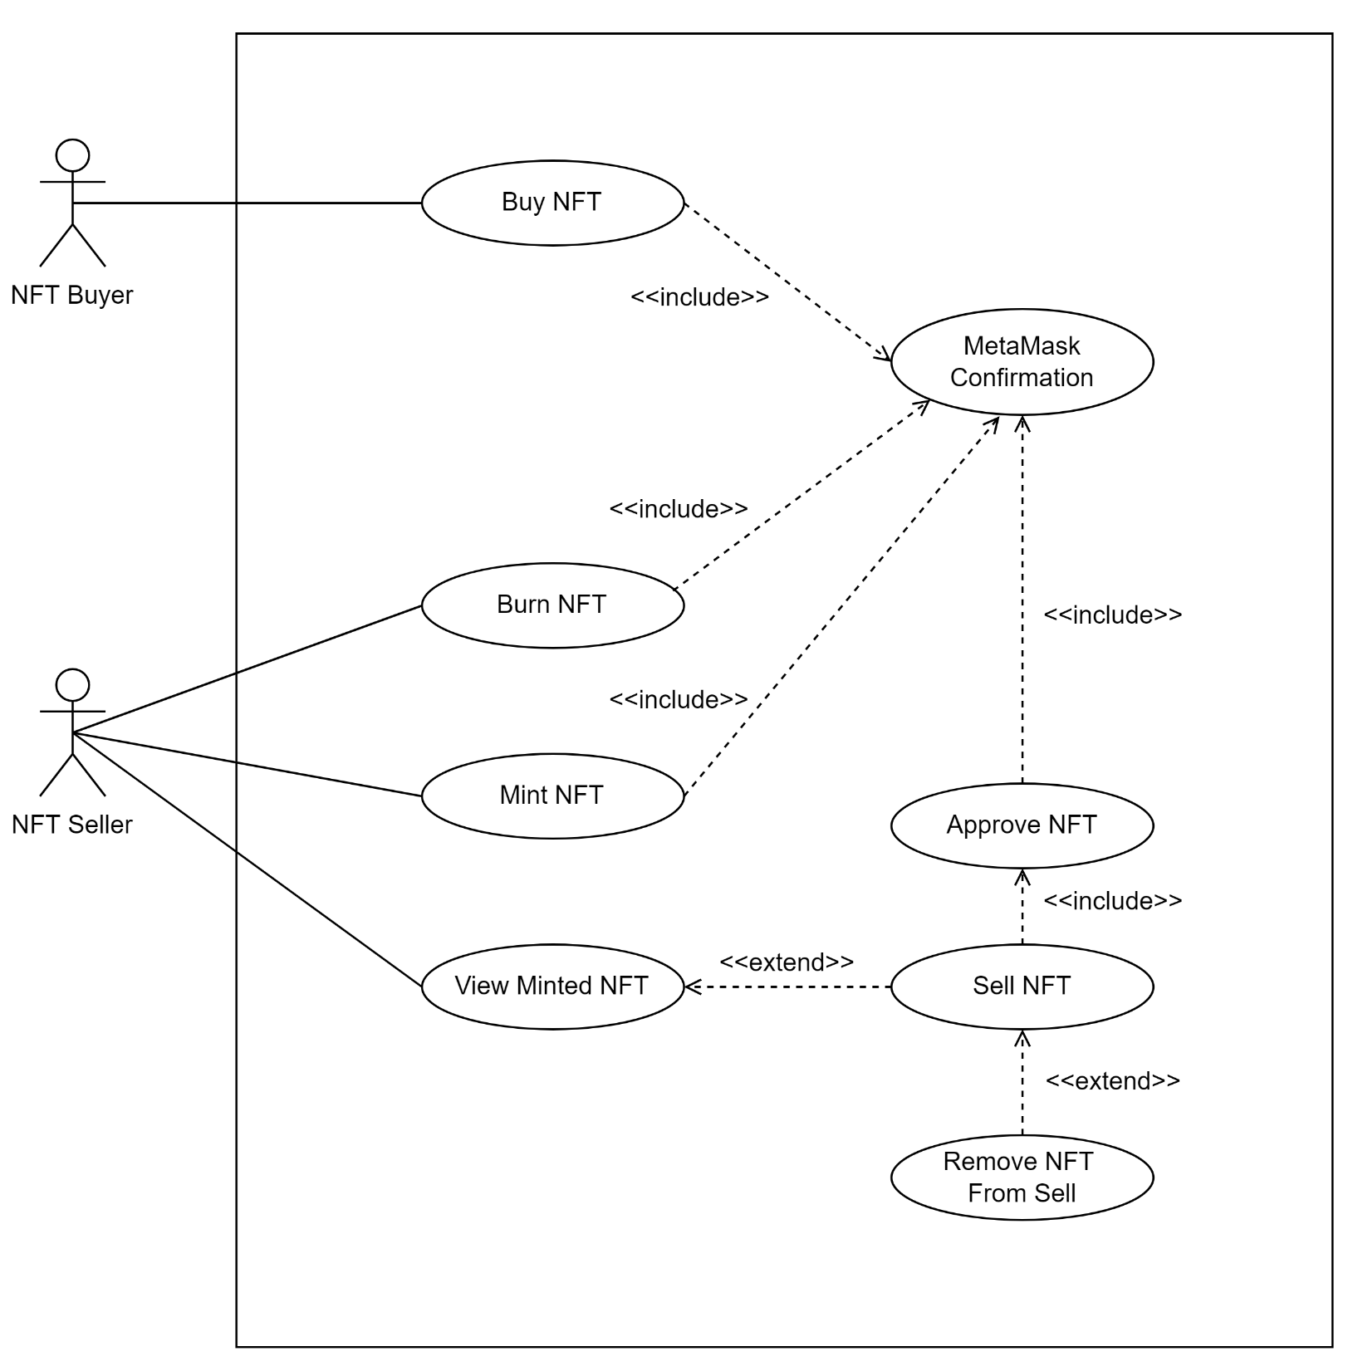
Use Case
Diagram

Slide 30
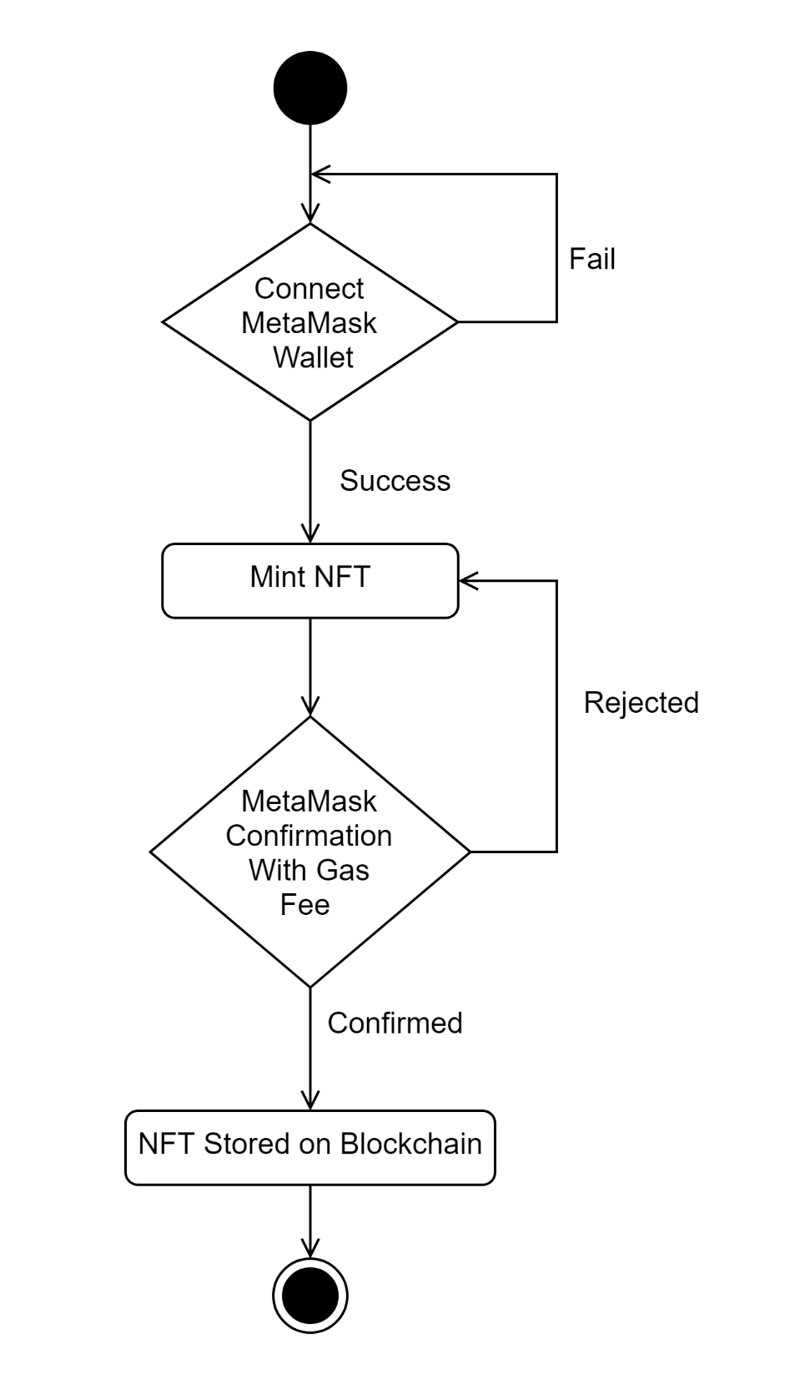
Activity Diagram:
Mint NFT

Slide 31
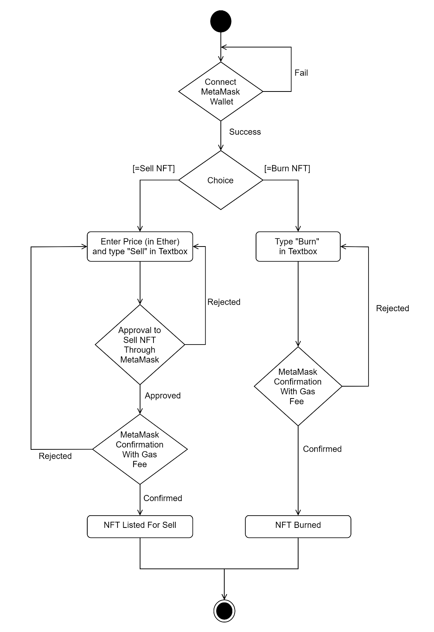
Activity Diagram:
Sell/Burn NFT

Slide 32
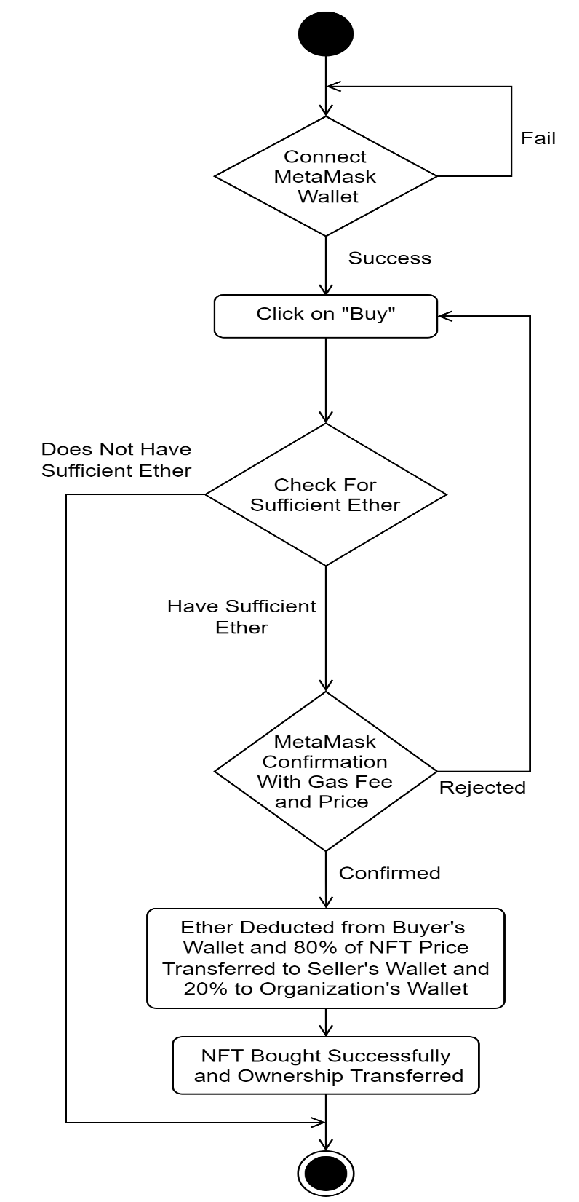
Activity Diagram:
Buy NFT

Slide 33
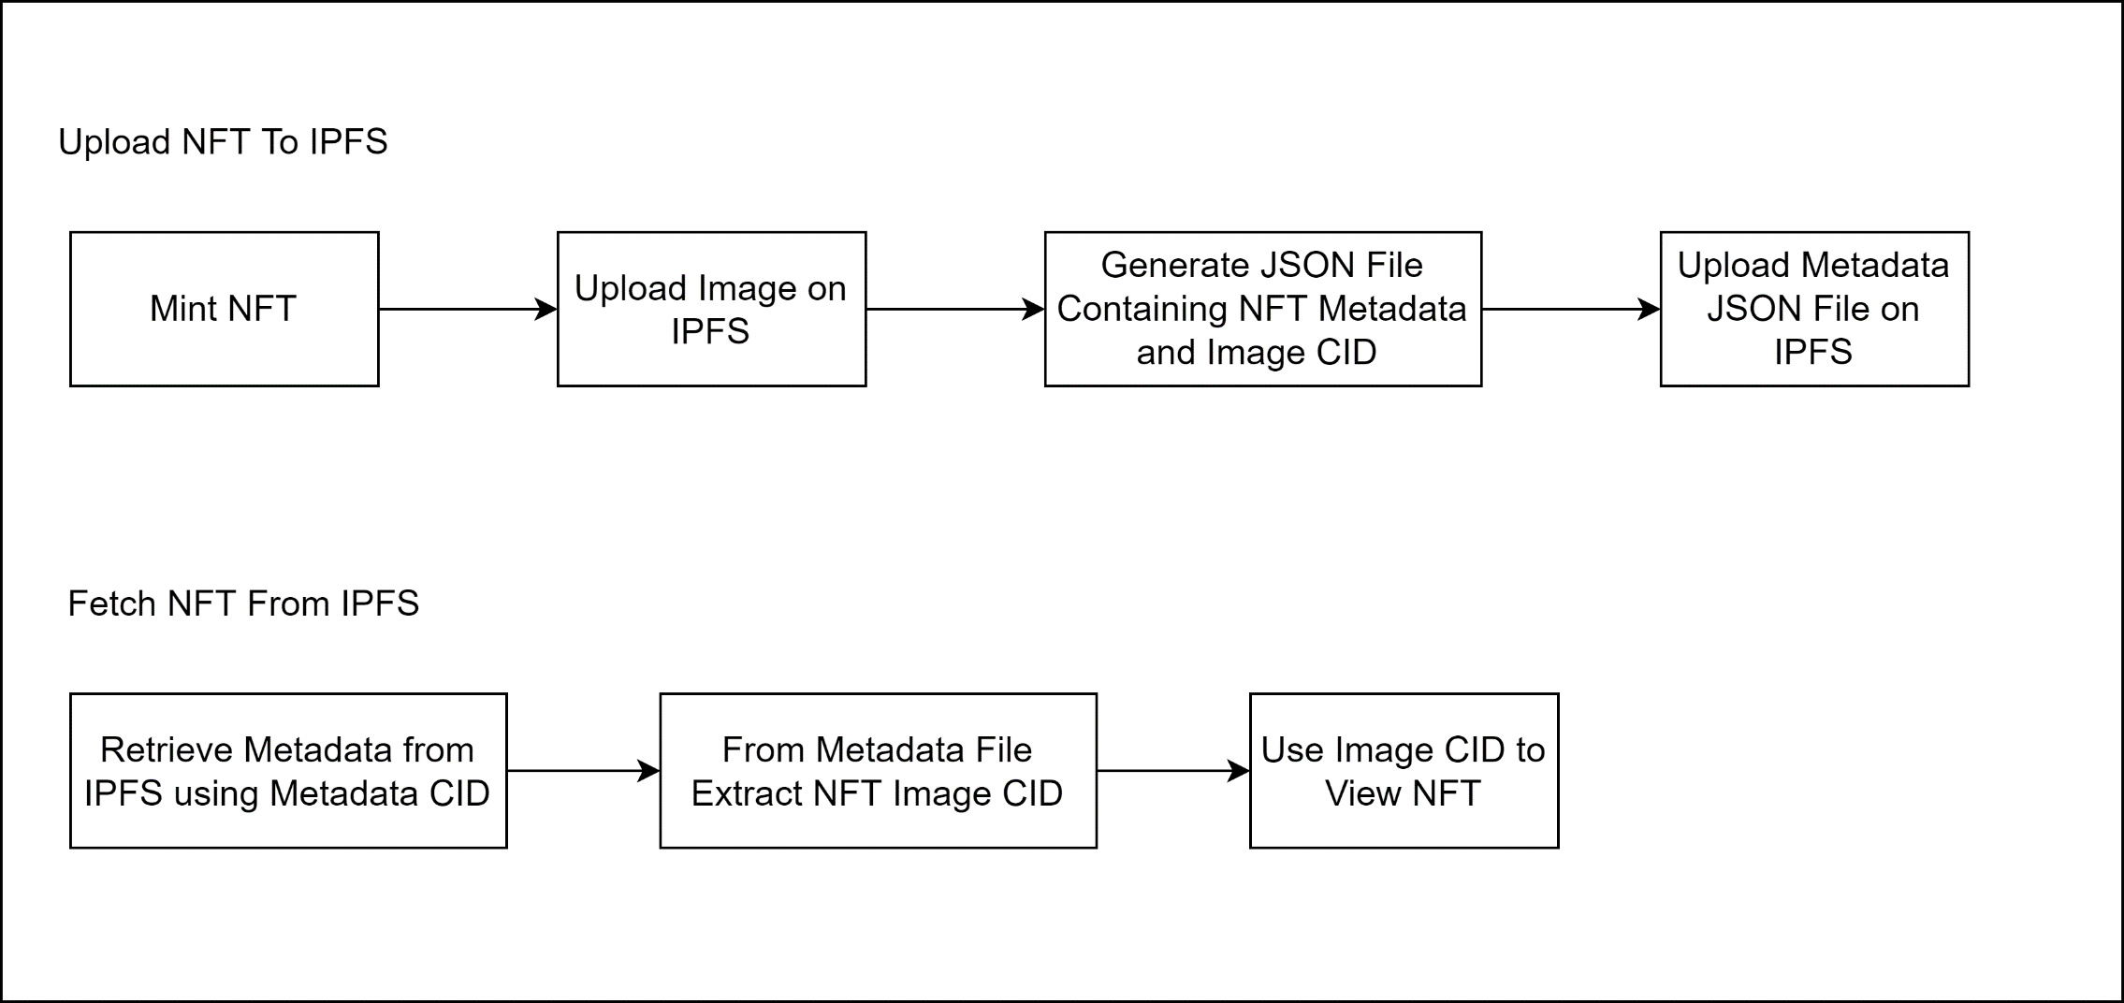
IPFS Workflow

Slide 34
Testing
Testing Methods Applied:
The various types of testing that have been applied to the project are:
Unit Testing: After development, each component has been tested individually whether it is working with proper functionality or not. Are there any bugs or problems in an individual component?
Integration Testing: After developing some components of the project, those components are integrated together logically and tested as a group to check after combining whether the project functionalities are working properly or not.
Black Box Testing: After developing and integrating the components together. Black box testing has been applied to check whether all the functionalities are working correctly or not. The users who don’t have technical/programming knowledge can also perform this testing.
White Box Testing: White Box Testing is a way of testing the software in which the tester has knowledge about the internal structure or the code or the program of the software. It is mostly done by software developers. Knowledge of the implementation of the project is very important.
Regression Testing: Regression testing has been applied at places where some changes has been made in the smart contracts/components or where new functionality has been added. This testing has been applied to check that whether by making these changes, the project old functionalities are working properly or not. “Are there any issues in the project old functionalities after making the changes in the project?” If there is any issue present or by making changes in one component other components are also getting affected, then that issue has been tried to resolve.

Slide 35
Test Cases
Mint NFT
Test Case ID | Test | Expected Input | Expected Output | Actual Result | Status
1. | To Mint an NFT | Name, Description, Image | MetaMask pop up for confirmation to pay gas fee, after confirming NFT should be minted successfully | NFT Minted Successfully | Pass
2. | To Mint an NFT after rejecting MetaMask confirmation | Name, Description, Image | NFT not Minted | NFT not Minted | Pass

Slide 36
Test Cases
Sell NFT
Test Case ID | Test | Expected Input | Expected Output | Actual Result | Status
1. | Sell NFT | Price (in Ether), Type “Sell” in textbox and click on Enter Button | MetaMask pop up for confirmation to pay gas fee and for approval, after confirming NFT should be Listed for Sale | NFT Listed for Sell Successfully. Now, Buyer can buy this NFT if he/she likes it. | Pass
2. | Sell NFT after rejecting MetaMask confirmation | Price (in Ether), Type “Sell” in textbox and click on Enter Button | NFT should not be Listed for Sale | NFT not Listed for Sale | Pass

Slide 37
Test Cases
Remove NFT from Sell
Test Case ID | Test | Expected Input | Expected Output | Actual Result | Status
1. | Remove NFT from Sell so, that Buyer cannot Buy | Click on Cancel Button | MetaMask pop up for confirmation to pay gas fee, after confirming NFT should be removed from Sell | NFT Removed from Sell | Pass
2. | Remove NFT from Sell after rejecting MetaMask confirmation | Click on Cancel Button | NFT should not be Removed from Sell | NFT not Removed from Sell | Pass

Slide 38
Test Cases
Buy NFT
Test Case ID | Test | Expected Input | Expected Output | Actual Result | Status
1. | To Buy NFT | Click on Buy Button | MetaMask pop up for confirmation to pay gas fee and price of NFT, after confirming NFT Ownership should be transferred to Buyer and 20% of NFT Price should be transferred to Organization’s Wallet | NFT Ownership Transferred Successfully and 20% of NFT Price Transferred to Organization’s Wallet | Pass
2. | Insufficient Funds to Buy NFT | Click on Buy Button | Not able to Buy NFT due to Insufficient Funds | Not able to Buy NFT due to Insufficient Funds | Pass

Slide 39
Test Cases
Burn NFT
Test Case ID | Test | Expected Input | Expected Output | Actual Result | Status
1. | To Burn NFT | Type “Burn” in textbox and click on Enter Button | MetaMask pop up for confirmation to pay gas fee, after confirming NFT Ownership should be transferred to Organization’s Wallet | NFT Burned Successfully | Pass
2. | Not able to Burn NFT, after rejecting MetaMask confirmation | Type “Burn” in textbox and click on Enter Button | Not able to Burn NFT | Not able to Burn NFT | Pass

Slide 40
Snapshots of Project

Slide 41
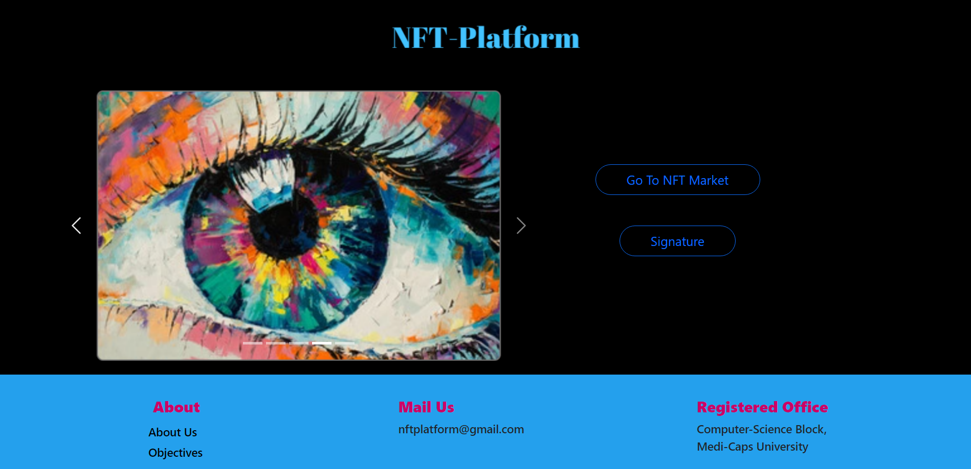
Home Page

Slide 42
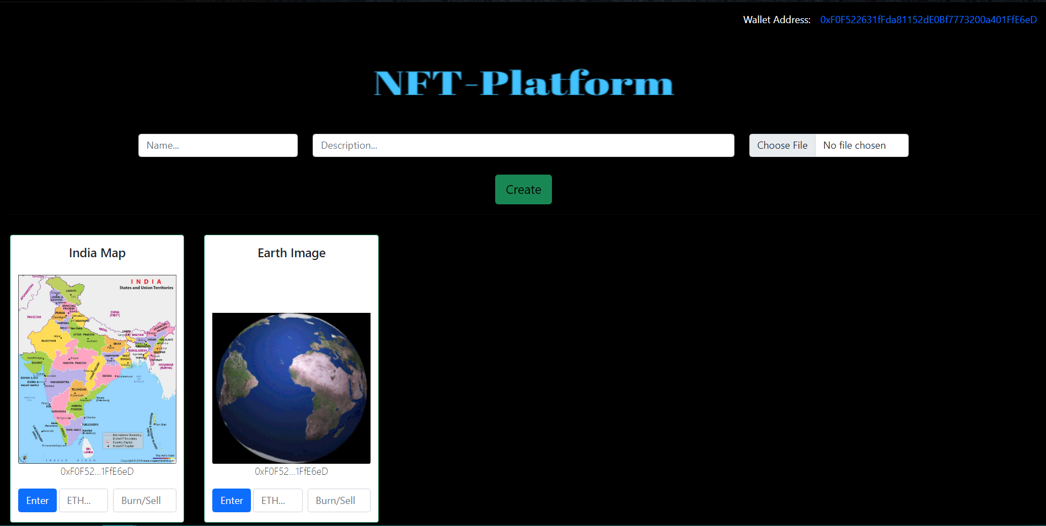
NFT Market

Slide 43
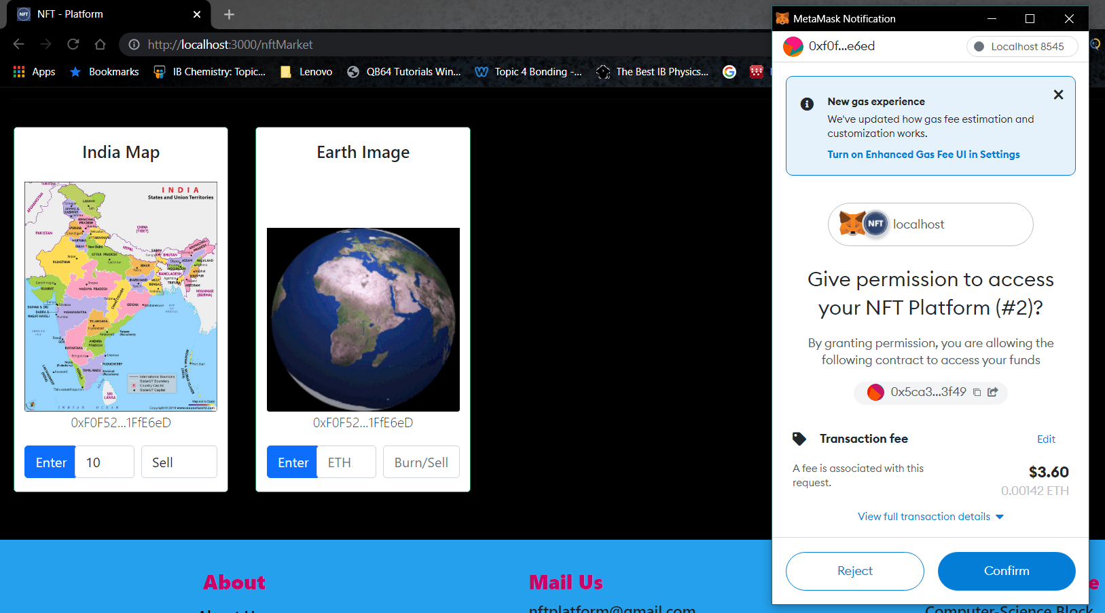
Approving NFT to Sell on the Marketplace

Slide 44
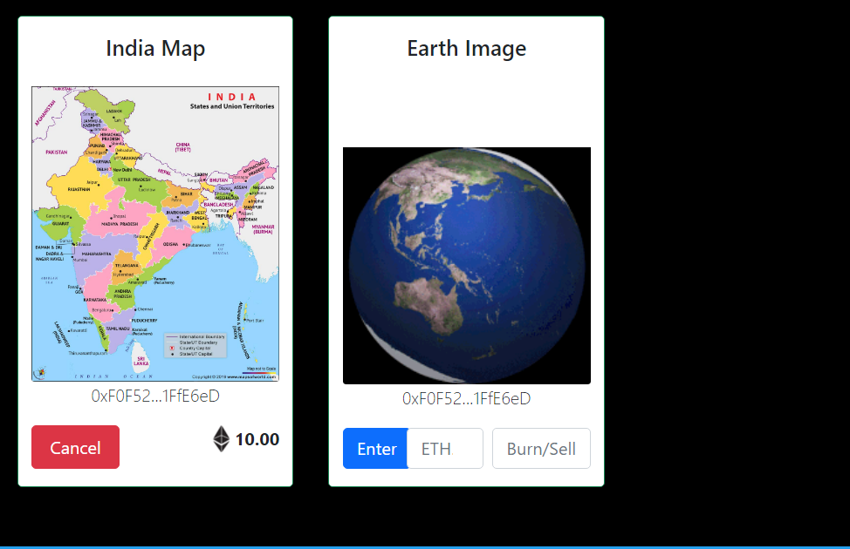
NFT Listed For Sell

Slide 45
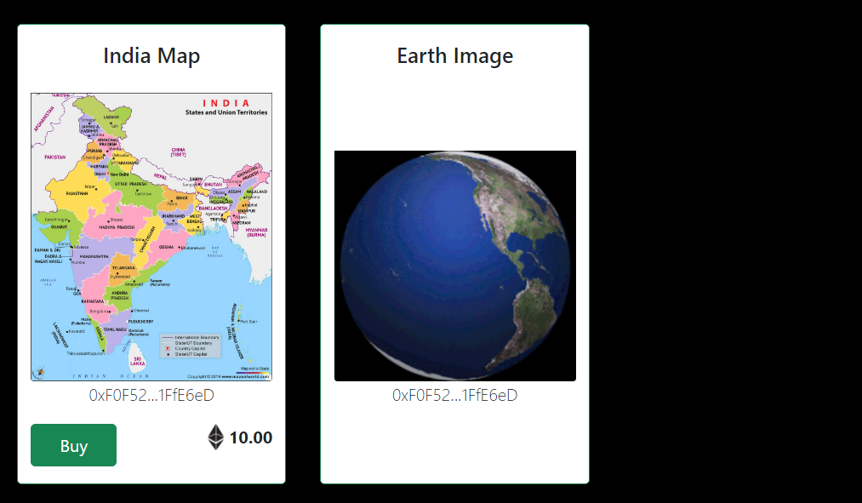
Buy NFT

Slide 46
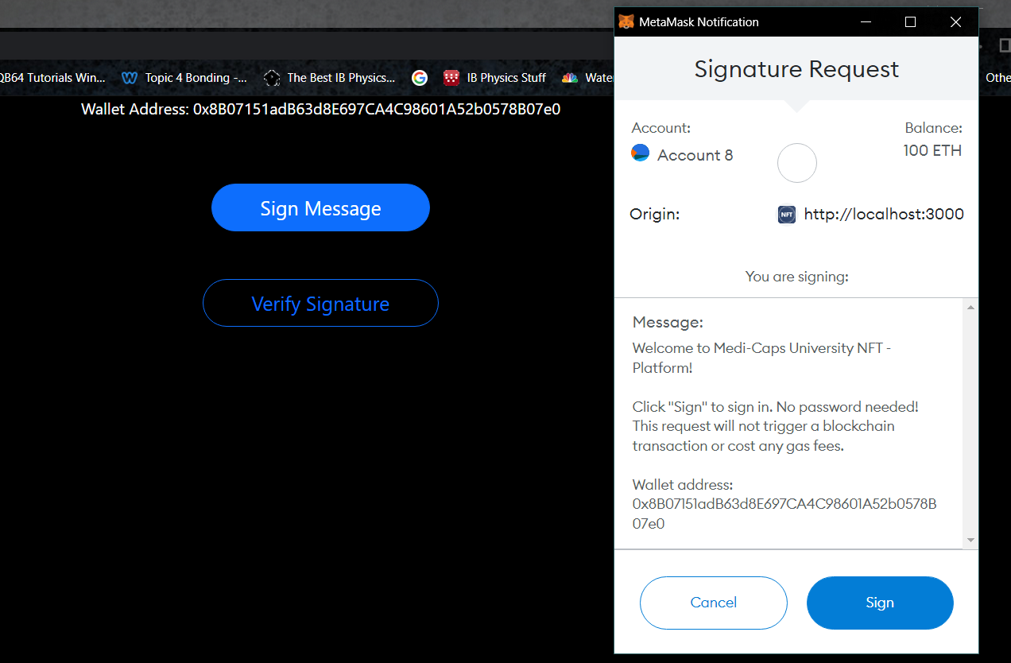
Signature

Slide 47
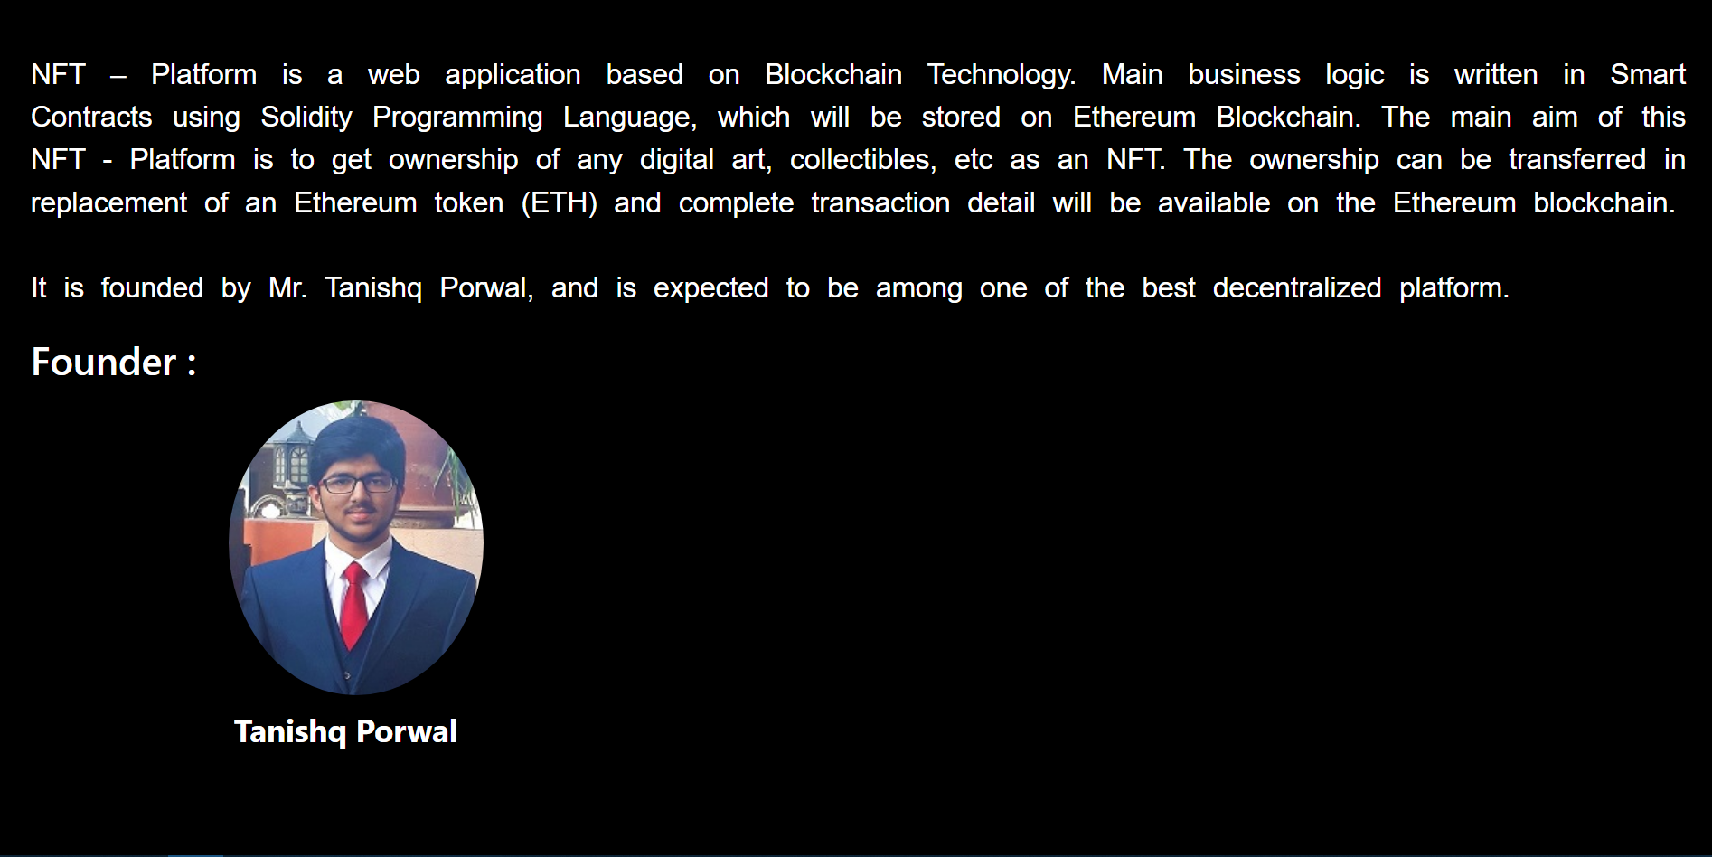
About Us

Slide 48
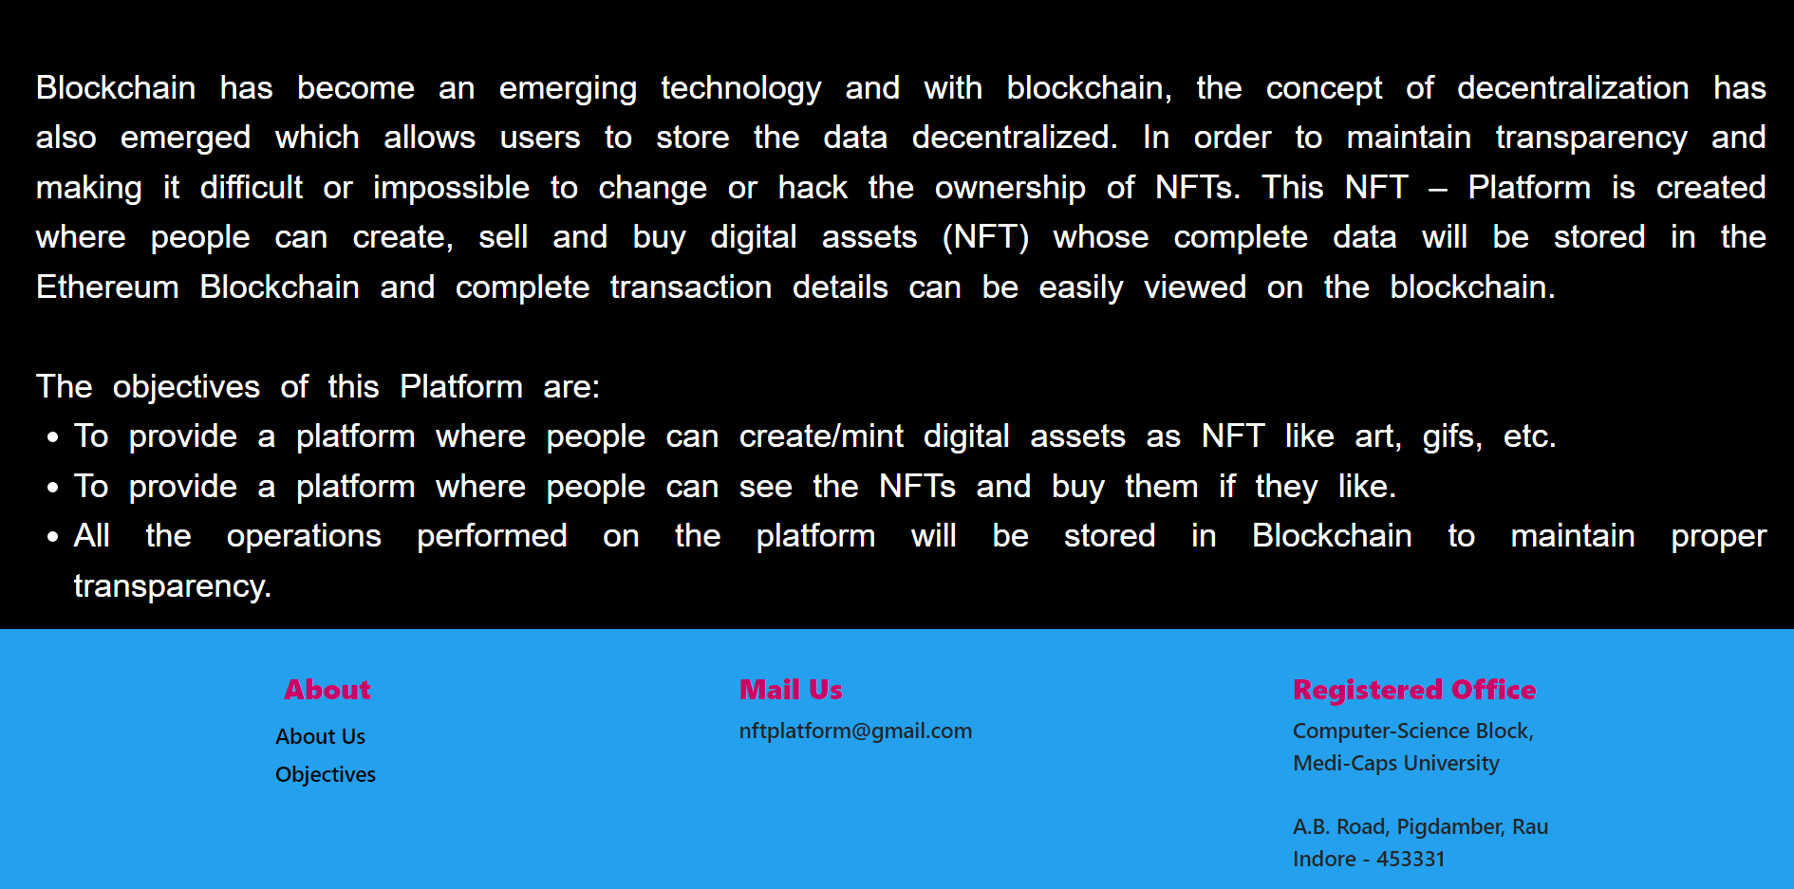
Objectives

Slide 49


